Slide 1
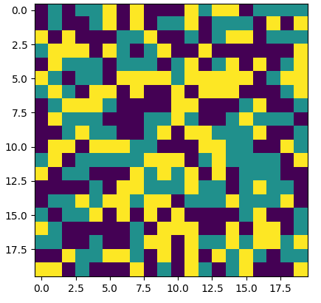
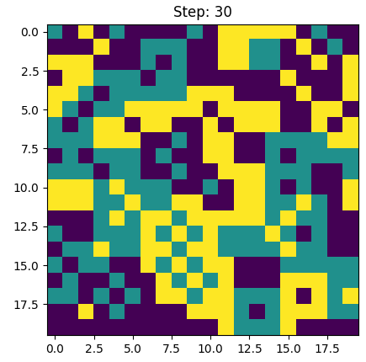
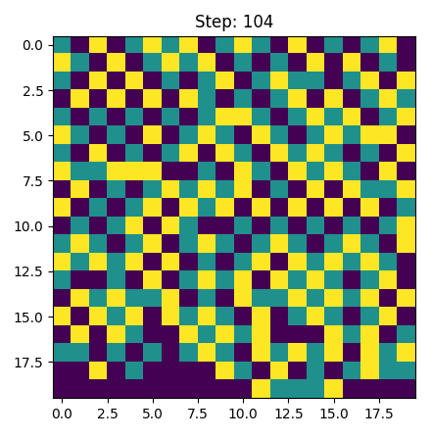
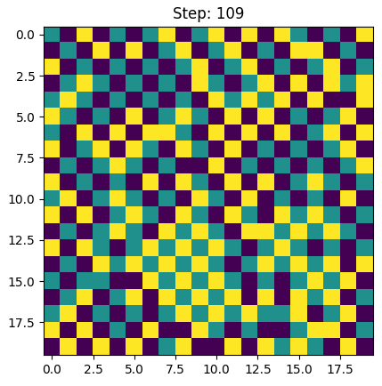
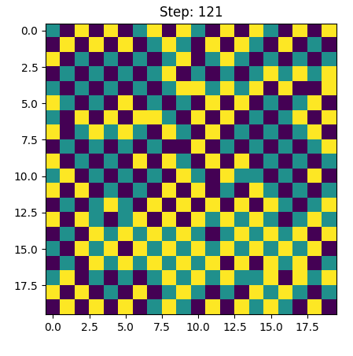
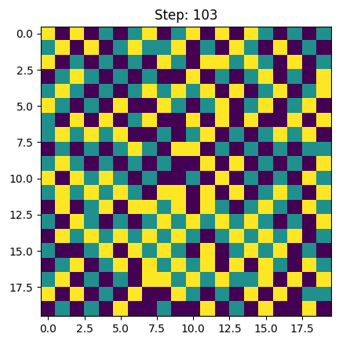
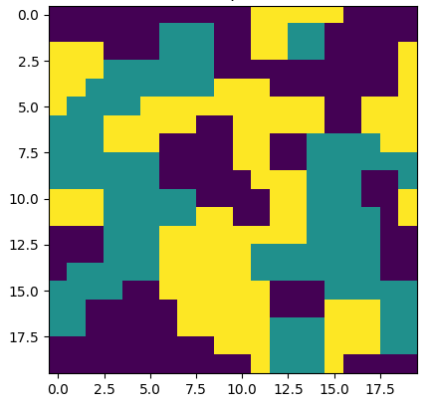
Random initialization
Binary utility
Type counting utility
Difference counting utility
Entropy: 0.794
CE: 0.650
Entropy: 0.647
CE: 0.553
Entropy: 0.838
CE: 0.908
Entropy: 0.804
CE: 0.966
Avg type and diff. counting utility
Entropy utility
Schelling initialization
Entropy: 0.778
CE: 0.979
Entropy: 0.825
CE: 0.941
Entropy: 0.416
CE: 0.254

